Slide 1
Predicting socioeconomic factors for potential gym members
Team:
Monisha Henry
Pretty Mathew Punnoor
Shahron Shaji
Supervisors:
James Williams
Zac Todd
Ricki Jones
Karen Slabbert

Slide 2
Background
Objectives
Assess key socioeconomic drivers.
Build predictive models for memberships.
Exploring the role of socioeconomic and demographic data in predicting gym membership behaviour.

Slide 3
Methodology
6. Hypothesis & Model Development
1. Census, CEL & first-party data
5. QGIS SA1 calculation &Data merge
2. Feature Extraction
4. Avg distance & conversion rate calculation
3.Development of indexes (BPI) (EI)

Slide 4
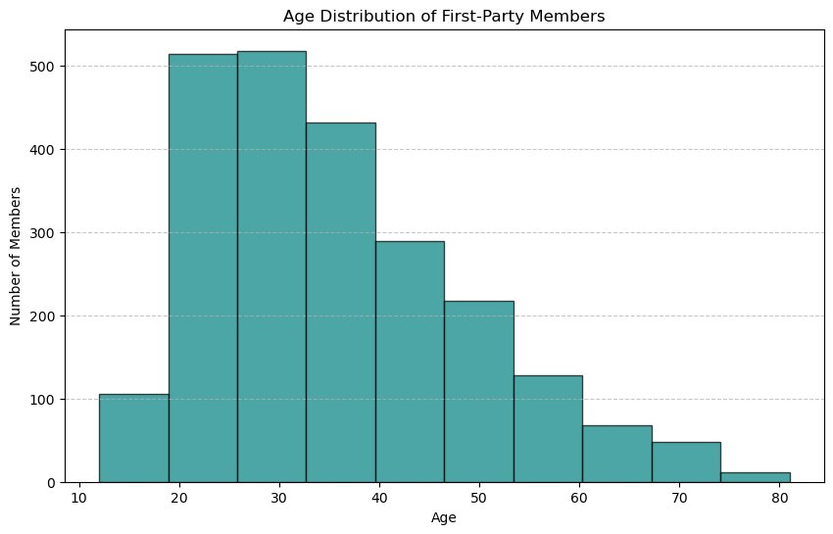
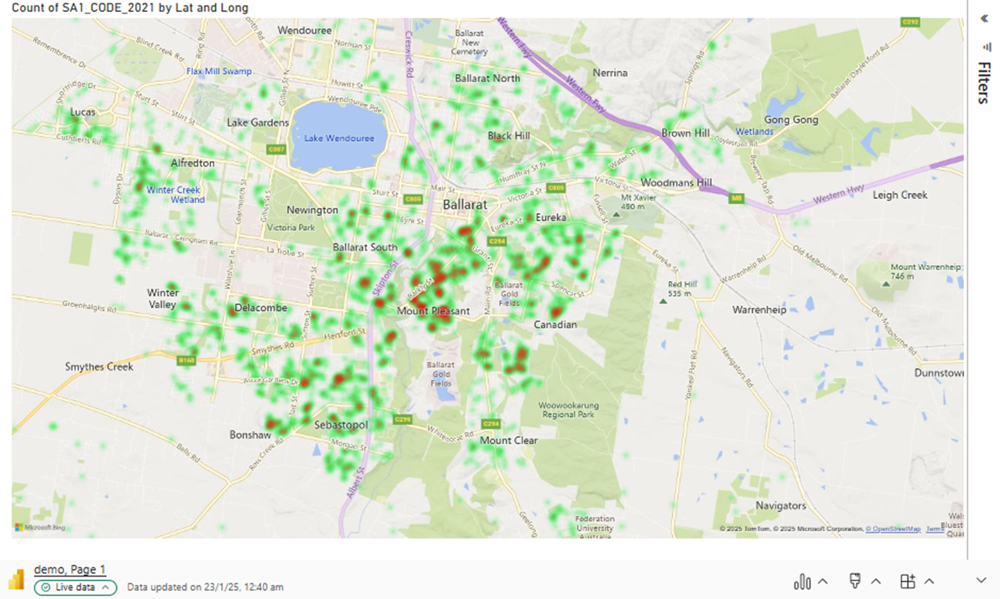
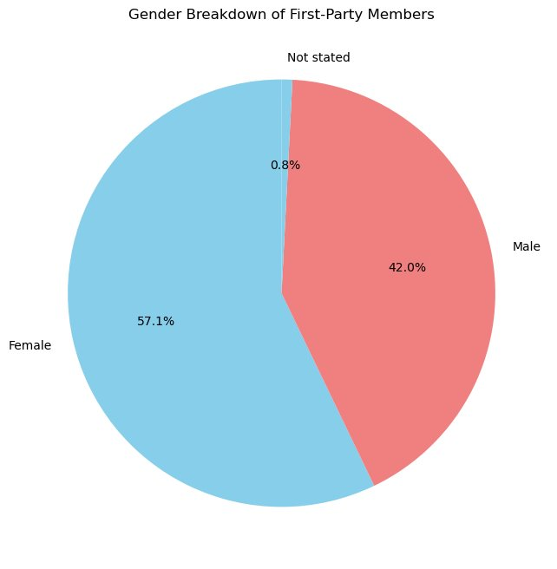
Data visualisation of first-party data

Slide 5
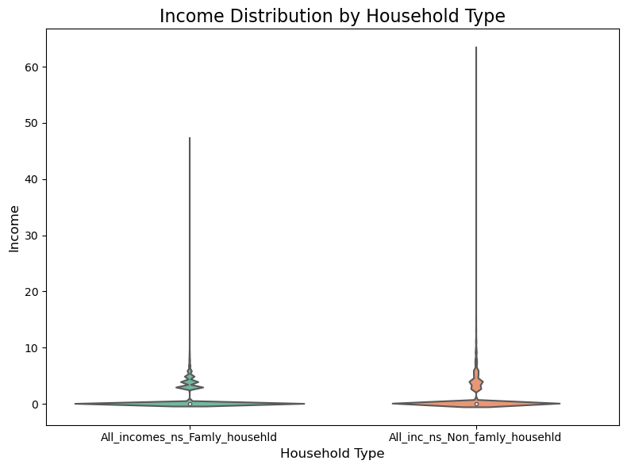
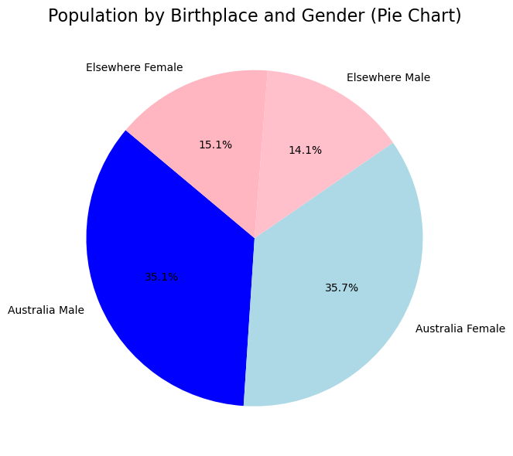
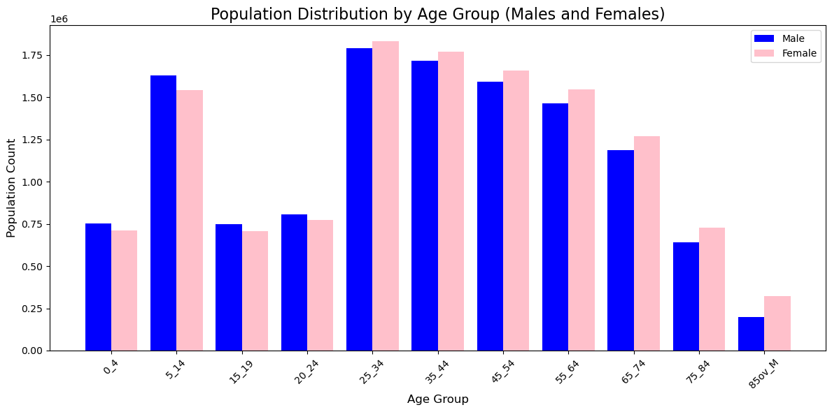
Data visualisation of Census data

Slide 6
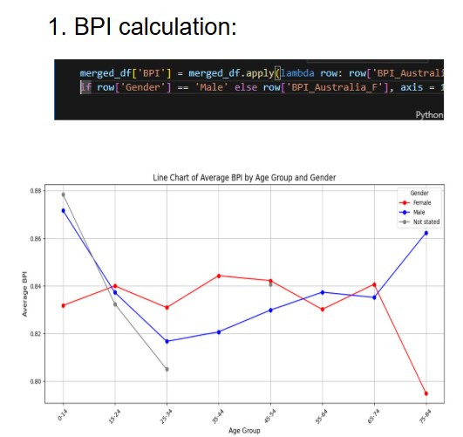
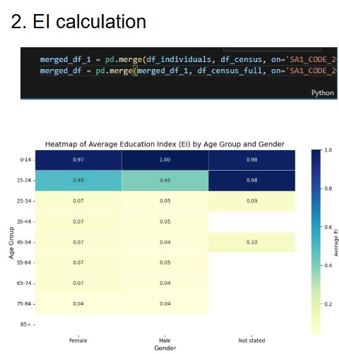
Feature extraction from Census Data

Slide 7
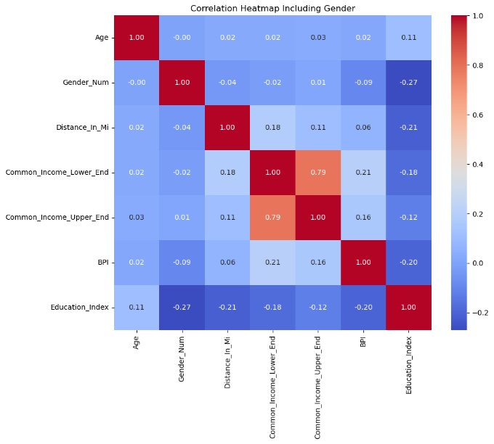
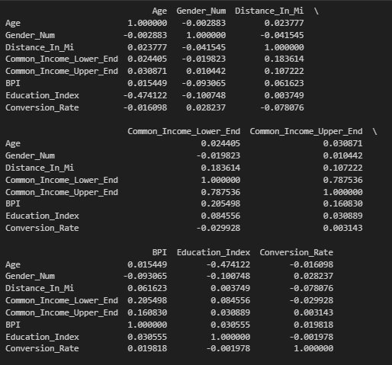
Correlation matrix and heatmap

Slide 8
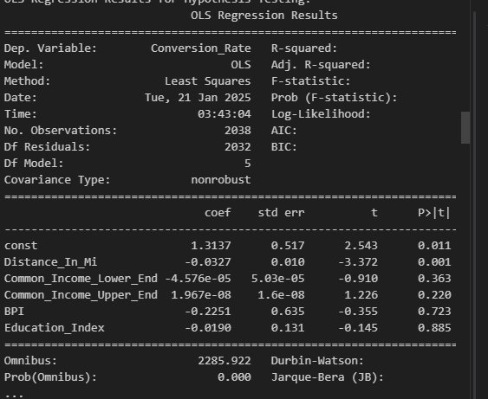
Hypothesis
Null Hypothesis (H0):
All predictors have no significant effect on the target variable.
Alternative Hypothesis (Ha):
At least one predictor has a significant effect on the target variable.

Slide 9
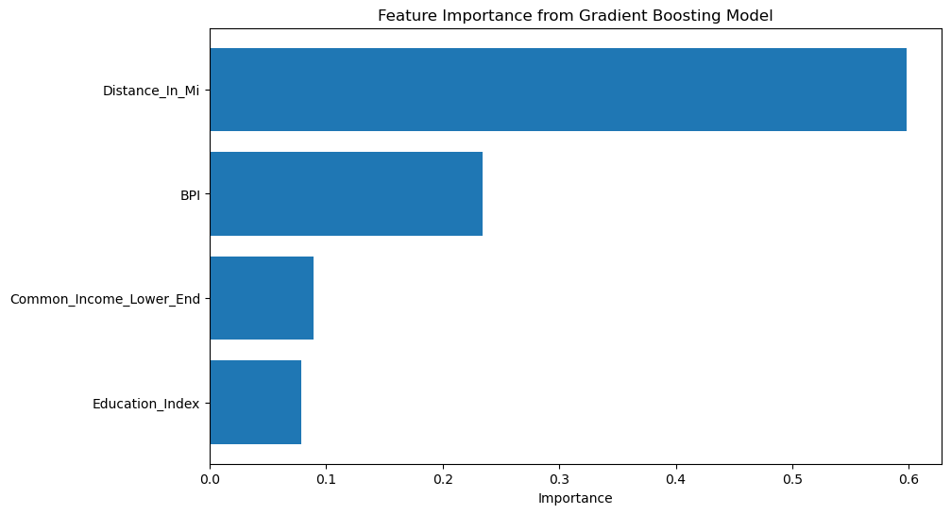
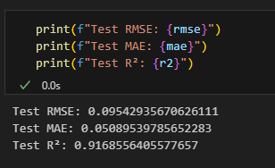
Model
Columns used: Distance_In_Mi, Common_Income_Lower_End, BPI, Education_Index.
Cleaned data, tested features, split, scaled, tuned model.
Trained Gradient Boosting Regressor to predict Conversion_Rate.

Slide 10
Challenges and limitations
Multicollinearity complicates factor analysis.
Overfitting risks reducing model generalizability.
External trends affect membership relevance.
Data bias limits broader applicability.

Slide 11
Conclusion
Successfully predicted gym memberships using socioeconomic data.
Tested with a different CEL dataset; results validated model accuracy.
Model proves effective and reliable.

Slide 12
Thank you Questions?

